Slide 1
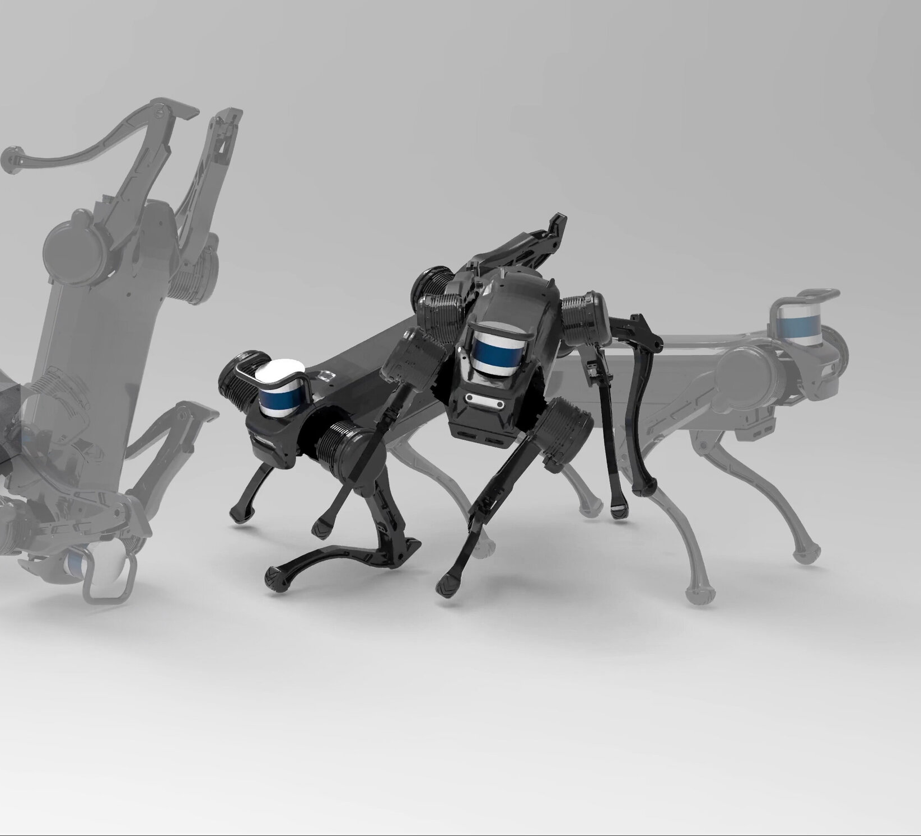
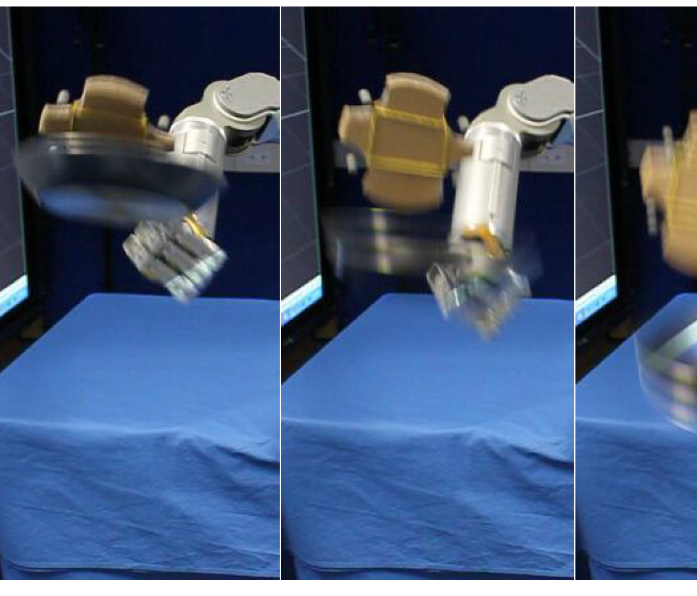
Reinforcement Learning

Slide 2

Classes of learning recap
Supervised Learning
Data: (data, label)
Goal: Learn function to map data to label
The model learns what is “an apple”
Unsupervised Learning
Data: (data) - no labels -
Goal: Learn underlying structure of the objects
The model learns which objects are similar to each others
Reinforcement Learning
Data: (state-action) pairs
Goal: Maximize future rewards after many time steps
The model learns that eating apples is good

Slide 3
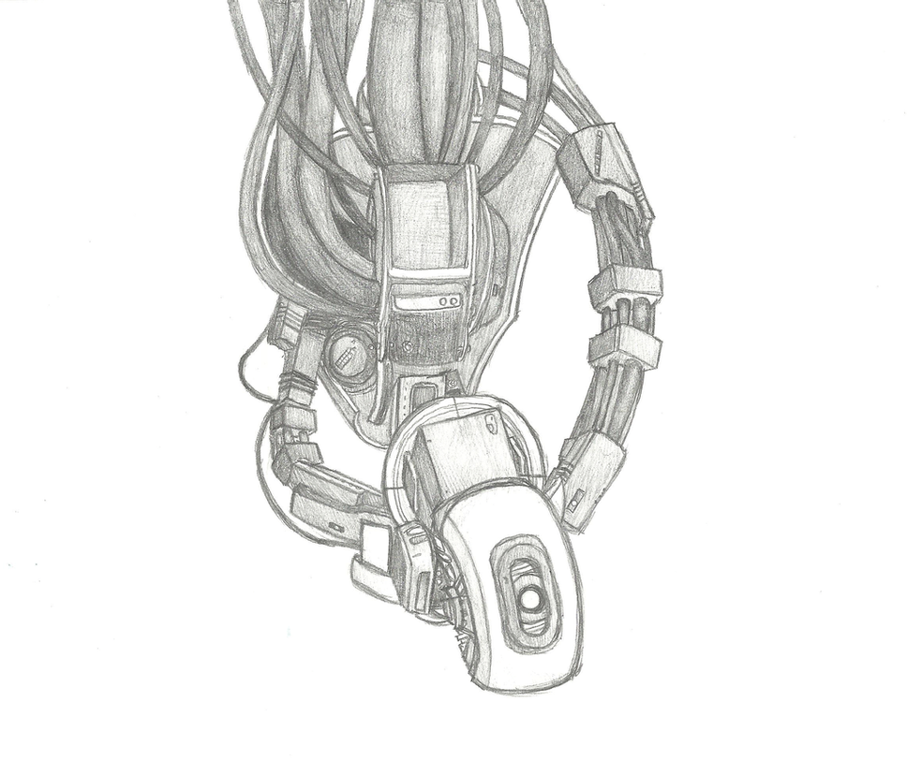
Definitions
States are observation of the system
Actions are the behavior of the agents when they see those states in the environment
Agent takes actions
Ex, you, a drone, Super Mario, GlaDOS, …
Environment is where the agent conducts its actions
Action space is the available actions for the agent
Notes:
Drawing by Darkrai4813

Slide 4
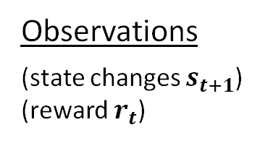
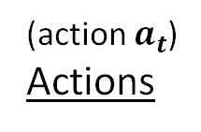
Definitions
Observations
(state changes $s_{t+1}$)
(reward $r_{t}$)
Agent
Environment
(action $a_{t}$)
Actions
State is a situation perceived by the agent (ex, an image perceived with your eyes)
Reward is a feedback that measures the success (or failure) of the agent’s action
It could be immediate or delayed

Slide 5
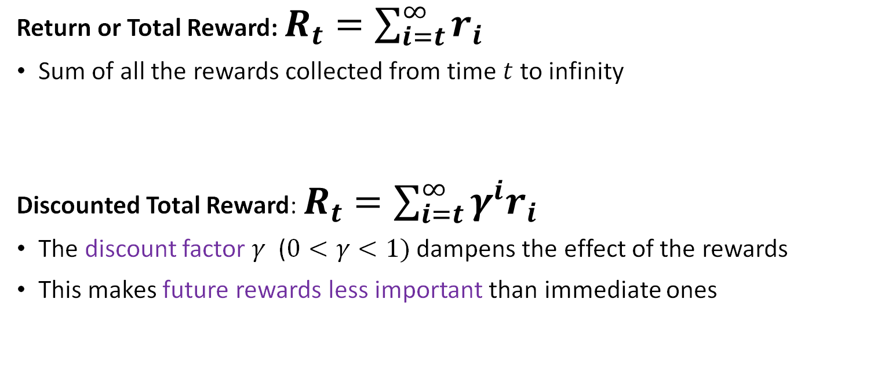
Total Reward
Return or Total Reward: $R_{t}=\sum_{i=t}^{∞}{r_{i}}$
Sum of all the rewards collected from time $t$ to infinity
Discounted Total Reward: $R_{t}=\sum_{i=t}^{∞}{{γ^{i}r}_{i}}$
The discount factor $γ$ ($0<γ<1)$ dampens the effect of the rewards
This makes future rewards less important than immediate ones

Slide 6
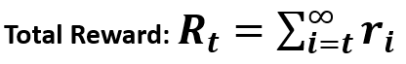
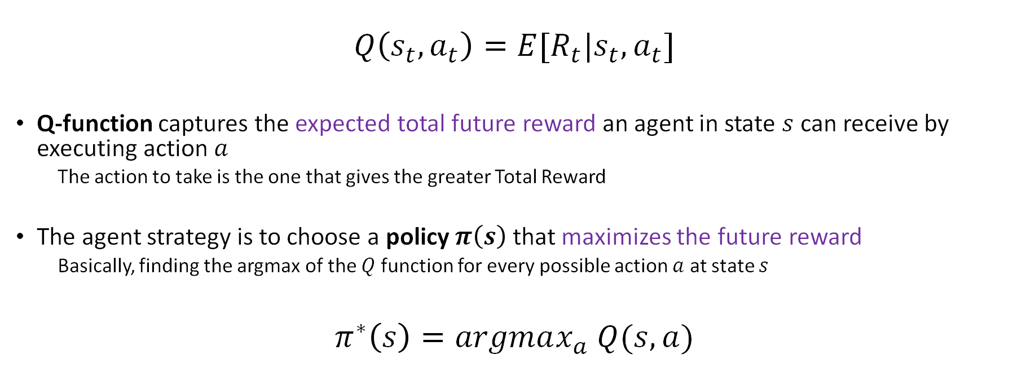
Q-function
$$Q\left(s_{t}, a_{t}\right)=E[R_{t}|s_{t},a_{t}]$$
Q-function captures the expected total future reward an agent in state $s$ can receive by executing action $a$
The action to take is the one that gives the greater Total Reward
The agent strategy is to choose a policy $π\left(s\right)$ that maximizes the future reward
Basically, finding the argmax of the $Q$ function for every possible action $a$ at state $s$
$$π^{∗}\left(s\right)=argmax_{a} Q(s,a)$$

Slide 7
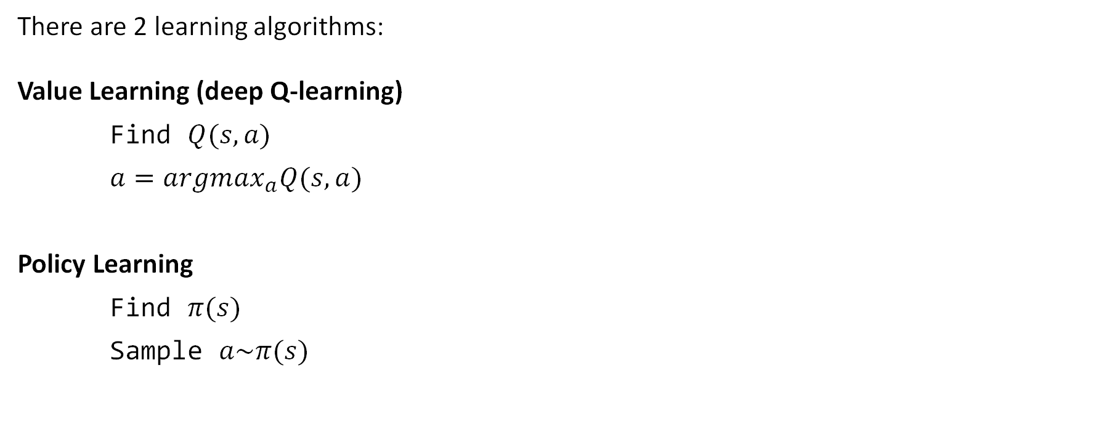
Deep Reinforcement Learning Algorithms
There are 2 learning algorithms:
Value Learning (deep Q-learning)
Find $Q(s,a)$
$a=argmax_{a}Q(s,a)$
Policy Learning
Find $π(s)$
Sample $a\sim π(s)$
Notes:
We’ll start from Value Learning (Q-learning)

Slide 8
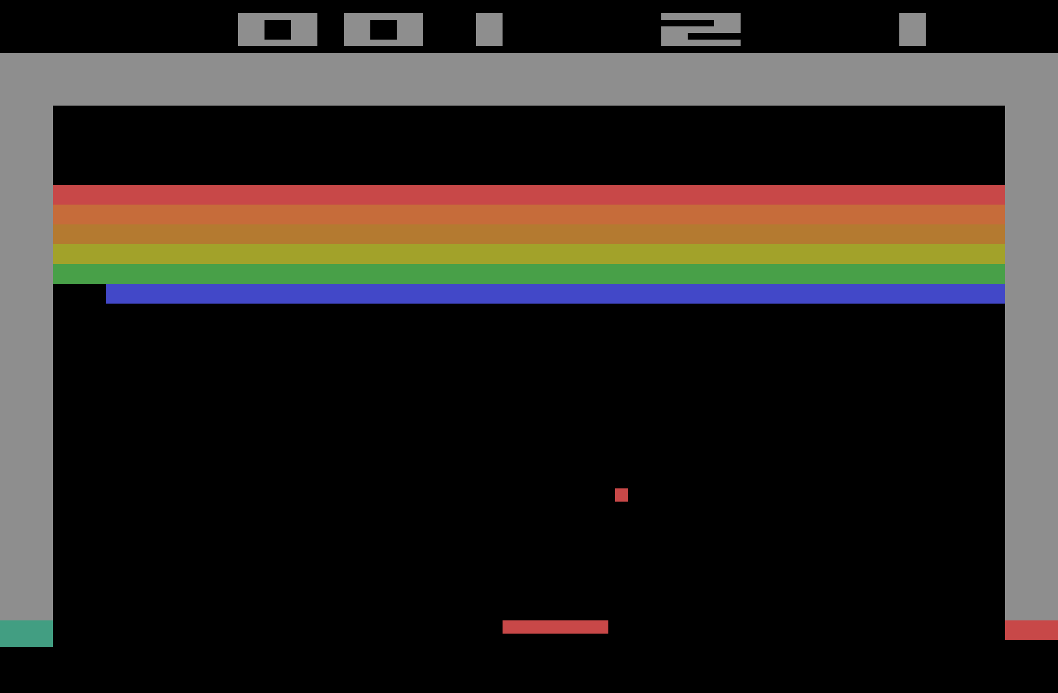
Value Learning
We’ll see an example on Value Learning where Reinforcement Learning is used to beat Atari videogames.
Google’s DeepMind Deep Q-Learning
The game in question is Breakout (1976)
Agent’s input: sensory information (screen pixels)
Goal: maximize game score on the higher portion of the screen
Nothing else! No domain knowledge about the game or the controls
You can read more here:
https://cs.stanford.edu/~rpryzant/data/rl/paper.pdf

Slide 9
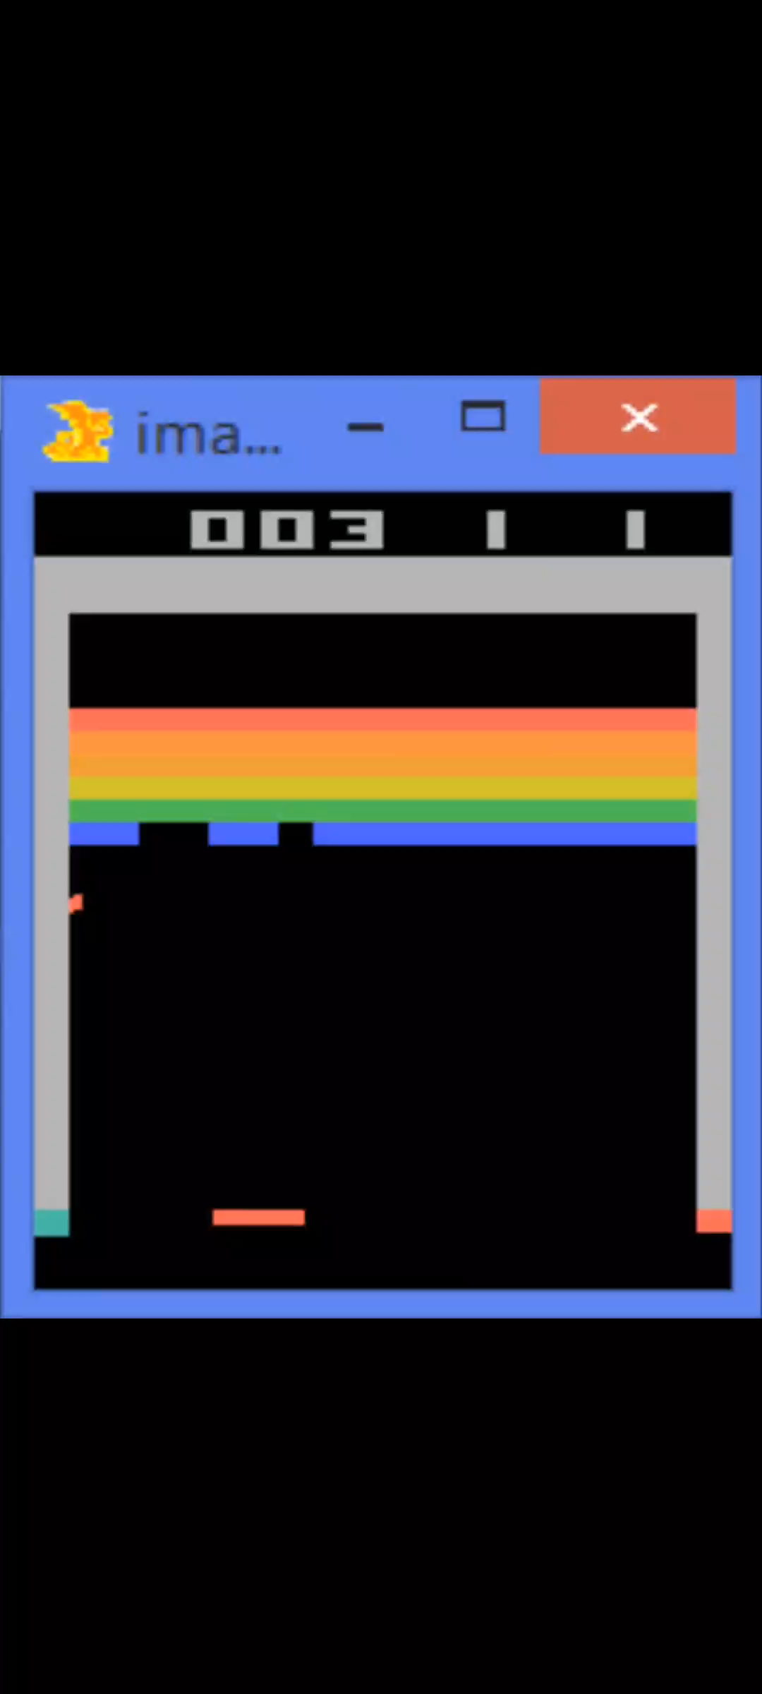
Value Learning
First 10 minutes, the agent is very clumsy

Slide 10
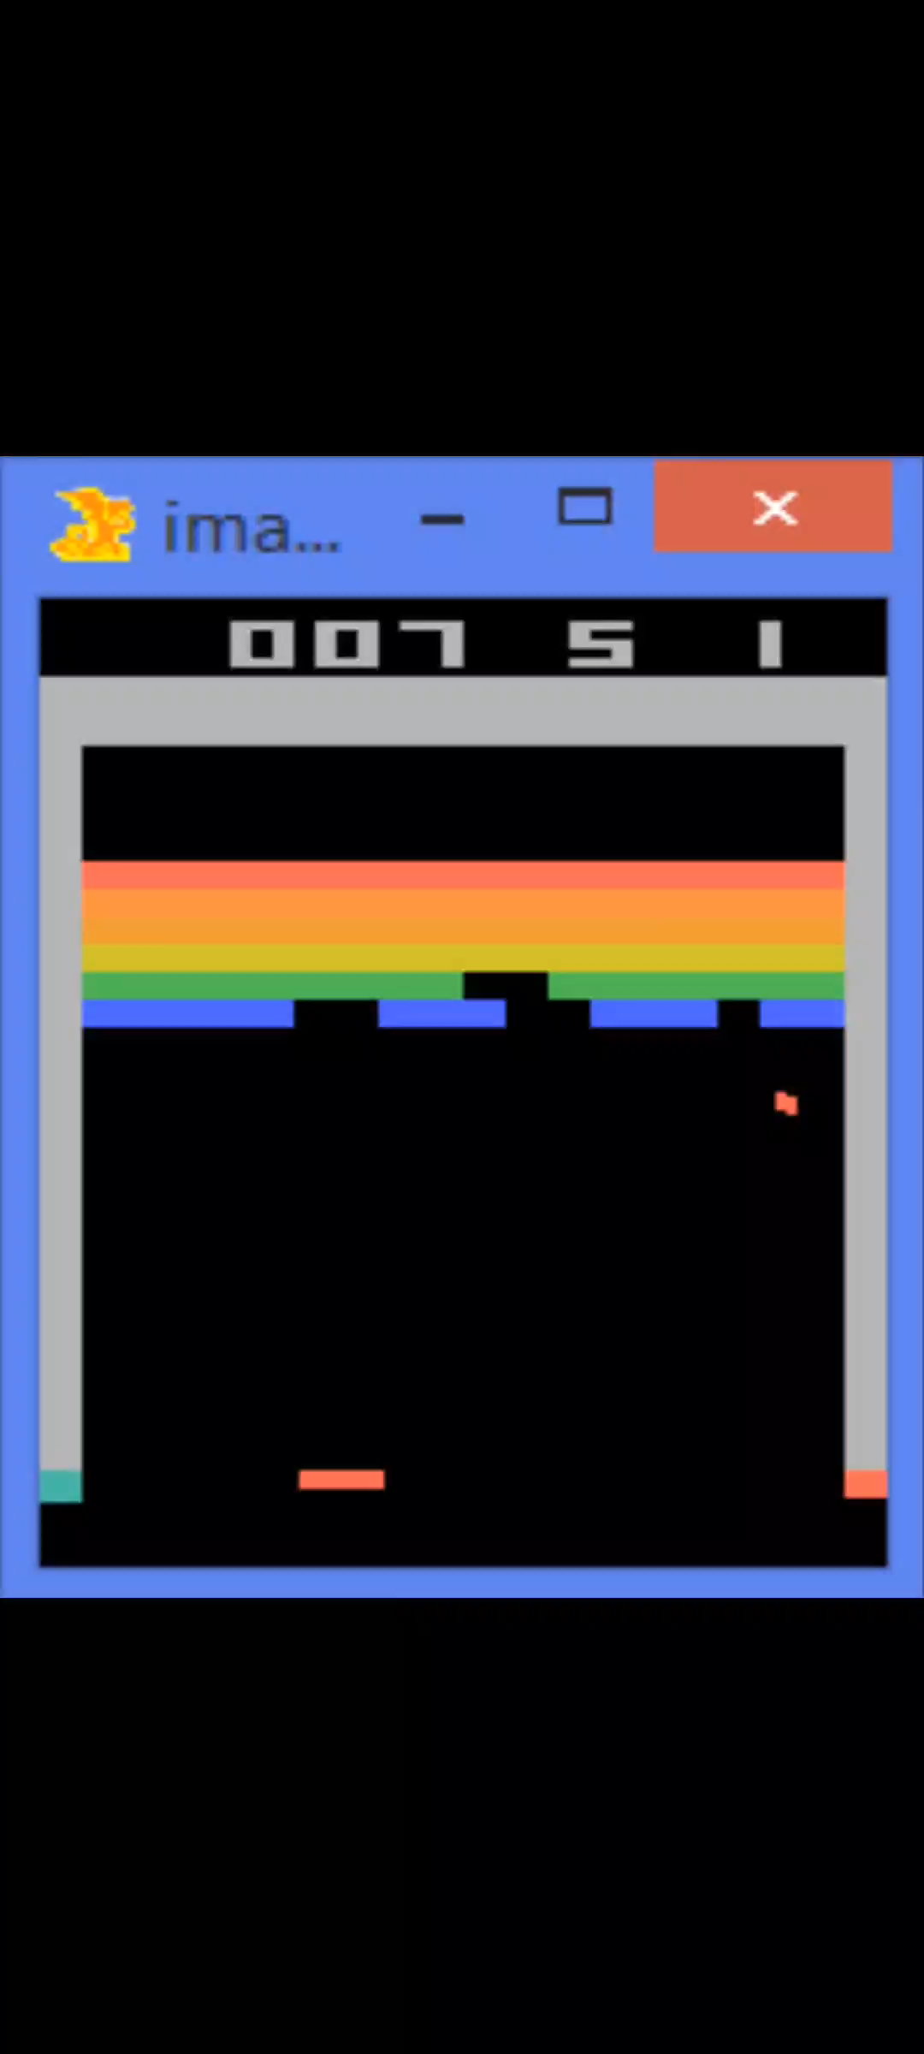
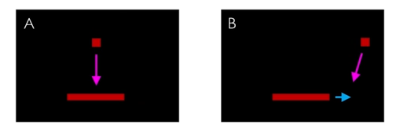
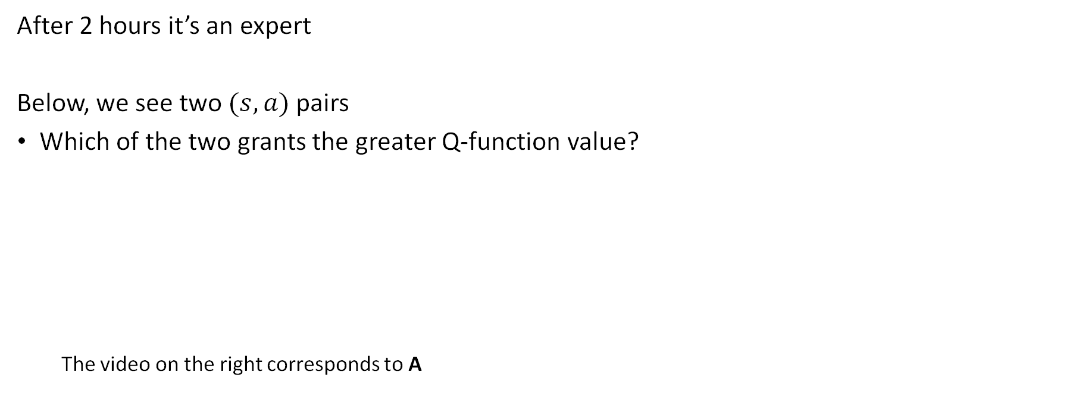
Value Learning
After 2 hours it’s an expert
Below, we see two $(s,a)$pairs
Which of the two grants the greater Q-function value?
The video on the right corresponds to A

Slide 11
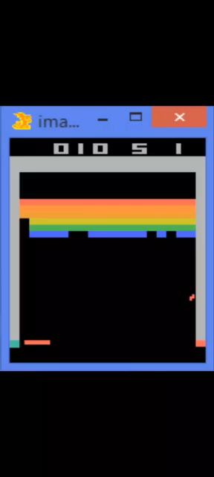
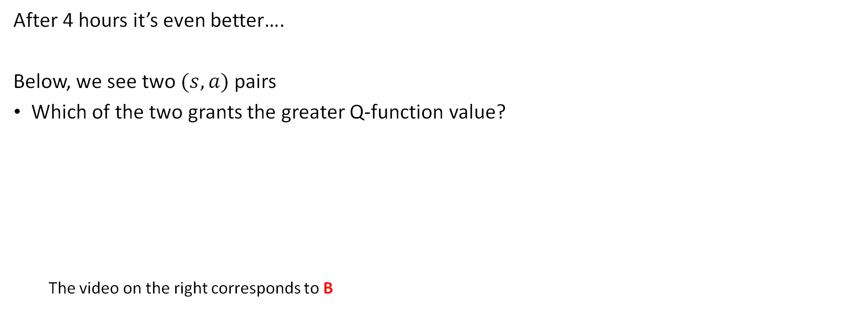
Value Learning
After 4 hours it’s even better….
Below, we see two $(s,a)$pairs
Which of the two grants the greater Q-function value?
The video on the right corresponds to B

Slide 12
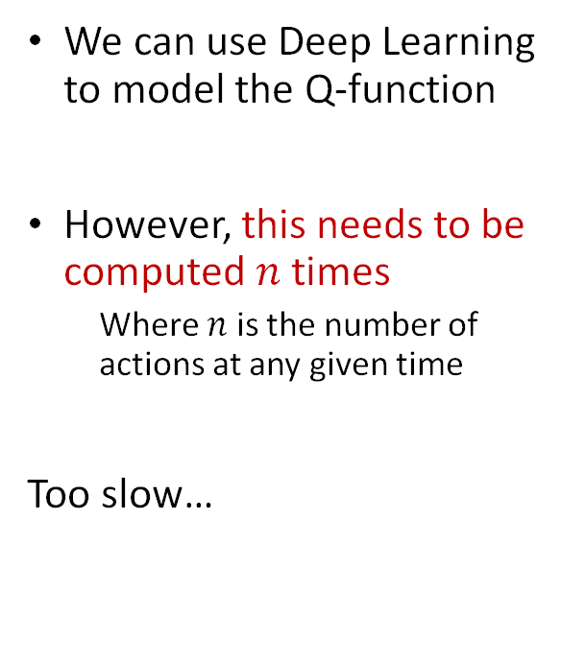
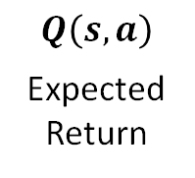
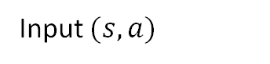
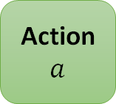
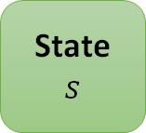
Modelling the Q-function
We can use Deep Learning to model the Q-function
However, this needs to be computed $n$ times
Where $n$ is the number of actions at any given time
Too slow…
State $s$
Deep Learning
$$Q\left(s, a\right)$$
Expected Return
Action $a$
Input $(s, a)$
Agent
Output

Slide 13
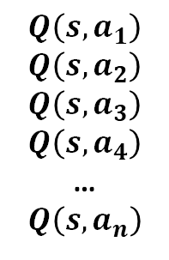
Modelling the Q-function
We can instead do this…
We output all the Q values at once
Much more convenient
But how to train this network?
We don’t have a dataset of “Q-values”
Expected Return
per each Action
Deep Learning
$$Q\left(s, a_{1}\right)$$
$$Q\left(s, a_{2}\right)$$
$$Q\left(s, a_{3}\right)$$
$$Q\left(s, a_{4}\right)$$
…
$$Q\left(s, a_{n}\right)$$
State $s$
Input $(s, a)$
Agent
Output

Slide 14
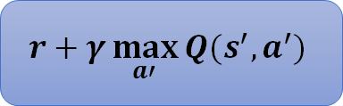
Modelling the Q-function
We know what the best Expected Return looks like
We create a Target were all the best actions are taken
Expected Return
per each Action
Deep Learning
$$Q\left(s, a_{1}\right)$$
$$Q\left(s, a_{2}\right)$$
$$Q\left(s, a_{3}\right)$$
$$Q\left(s, a_{4}\right)$$
…
$$Q\left(s, a_{n}\right)$$
State $s$
$$r+γ\max_{a′}{Q(s^{′}, a^{′})}$$
Target
Input $(s, a)$
Agent
Output

Slide 15
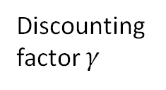
Modelling the Q-function
Expected Return
per each Action
Discounting factor $γ$
Action that max the Expected Return for the next/future state
Deep Learning
$$Q\left(s, a_{1}\right)$$
$$Q\left(s, a_{2}\right)$$
$$Q\left(s, a_{3}\right)$$
$$Q\left(s, a_{4}\right)$$
…
$$Q\left(s, a_{n}\right)$$
Initial Reward
State $s$
$$r+γ\max_{a′}{Q(s^{′}, a^{′})}$$
Target
Input $(s, a)$
Agent
Output

Slide 16
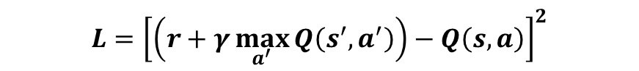
Q-Loss and DQN
Okay, but we need a Q-Loss
Loss = Predicted value - target
Expected Return
per each Action
Deep Learning
$$Q\left(s, a_{1}\right)$$
$$Q\left(s, a_{2}\right)$$
$$Q\left(s, a_{3}\right)$$
$$Q\left(s, a_{4}\right)$$
…
$$Q\left(s, a_{n}\right)$$
State $s$
$$L={\left[\left(r+γ\max_{a^{′}}{Q\left(s^{′}, a^{′}\right)}\right)−Q\left(s,a\right)\right]}^{2}$$
Target
Predicted Value
Input $(s, a)$
Agent
Output

Slide 17
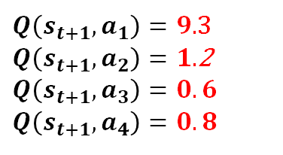
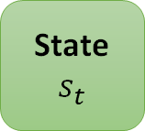
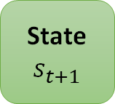
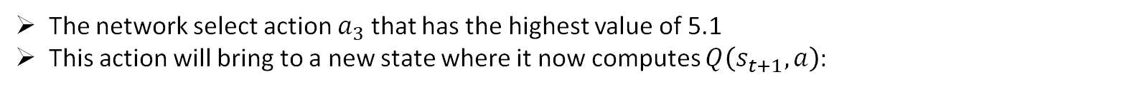
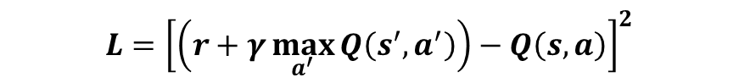
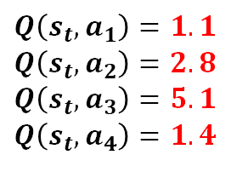
Q-Loss - Example
$$L={\left[\left(r+γ\max_{a^{′}}{Q\left(s^{′}, a^{′}\right)}\right)−Q\left(s,a\right)\right]}^{2}$$
Deep Learning
$Q\left(s_{t}, a_{1}\right)=1.1$ $Q\left(s_{t}, a_{2}\right)=2.8$
$$Q\left(s_{t}, a_{3}\right)=5.1$$
$$Q\left(s_{t}, a_{4}\right)=1.4$$
State $s_{t}$
Selected Action
The network select action $a_{3}$ that has the highest value of 5.1
This action will bring to a new state where it now computes $Q\left(s_{t+1},a\right)$:
Deep Learning
$Q\left(s_{t+1}, a_{1}\right)=9.$3 $Q\left(s_{t+1}, a_{2}\right)=1.$2
$$Q\left(s_{t+1}, a_{3}\right)=0.6$$
$$Q\left(s_{t+1}, a_{4}\right)=0.8$$
State $s_{t+1}$
If $γ=1$, and $r_{t}=2$, then: $L={\left[(r+γ∗Q\left(s_{t+1},a_{1}\right)−Q(s_{t},a_{3})\right]}^{2}={\left[2+(1∗9.3) −5.1\right]}^{2}={6.2}^{2}$
$a^{′}$ is the best action, that is, the one giving the maximum Q value [$a_{1}$ here]
Notes:
This is individual per every (state, action) pair

Slide 18
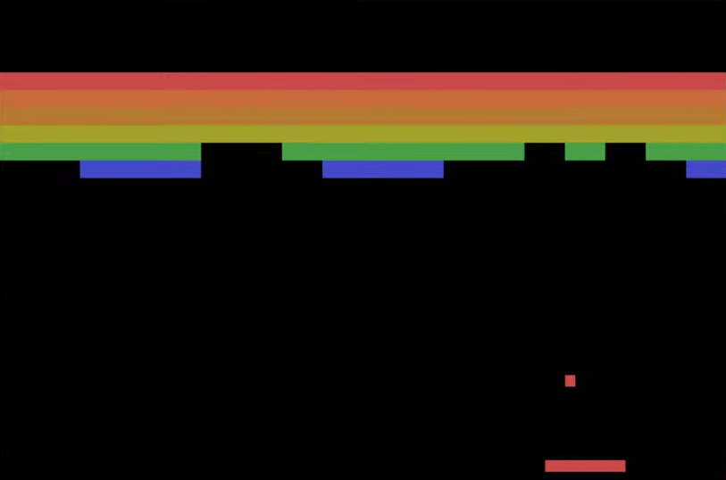
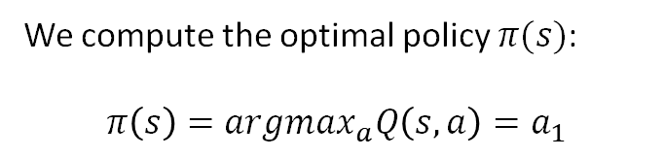
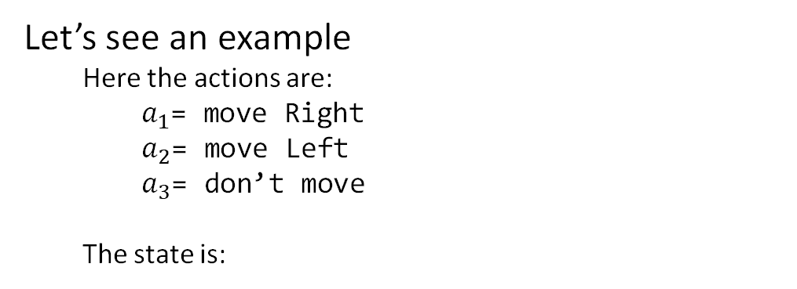
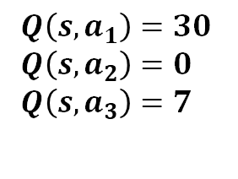
Q-Loss and DQN
Let’s see an example
Here the actions are:
$a_{1}$= move Right
$a_{2}$= move Left
$a_{3}$= don’t move
The state is:
Deep Learning
State $s$
$Q\left(s, a_{1}\right)=30$
$Q\left(s, a_{2}\right)=0$
$Q\left(s, a_{3}\right)=7$
We compute the optimal policy $π(s)$:
$π\left(s\right)=argmax_{a}Q\left(s,a\right)=a_{1}$

Slide 19
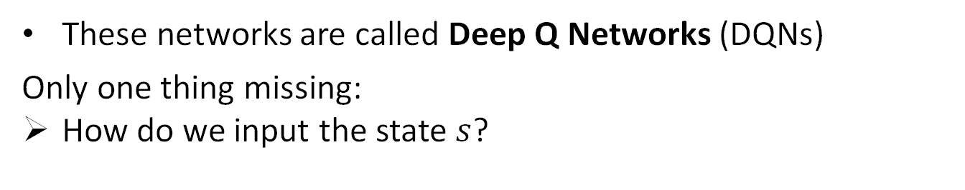
Q-Loss and DQN
These networks are called Deep Q Networks (DQNs)
Only one thing missing:
How do we input the state $s$?
Deep Learning
State $s$
$Q\left(s, a_{1}\right)=30$
$Q\left(s, a_{2}\right)=0$
$Q\left(s, a_{3}\right)=7$
We compute the optimal policy $π(s)$:
$π\left(s\right)=argmax_{a}Q\left(s,a\right)=a_{1}$

Slide 20
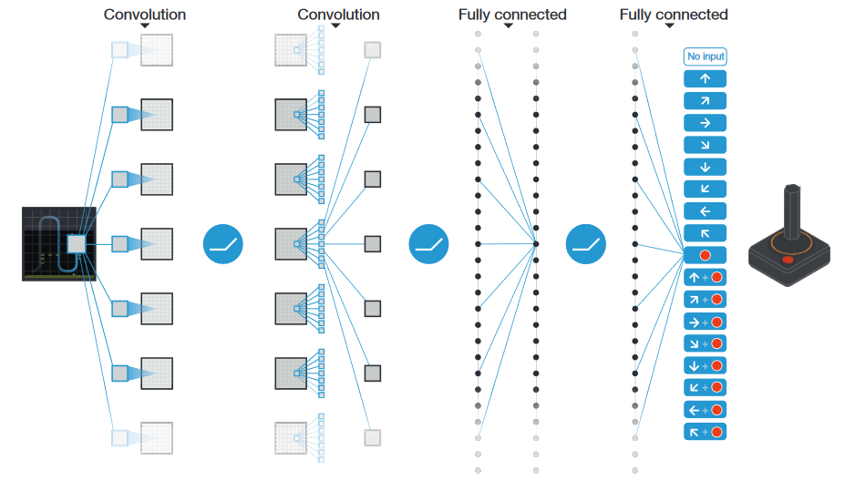
Q-Loss and DQN
We use convolutional layers, non-linearity, and pooling (basically, CNN)
It seems simplistic…
…but works!
(for the majority of the time)

Slide 21
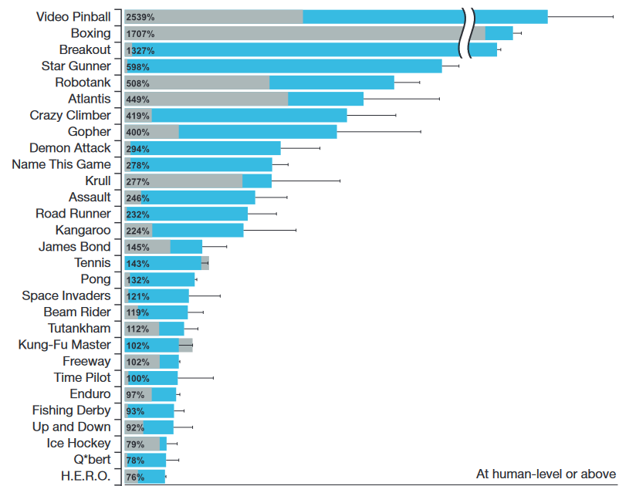
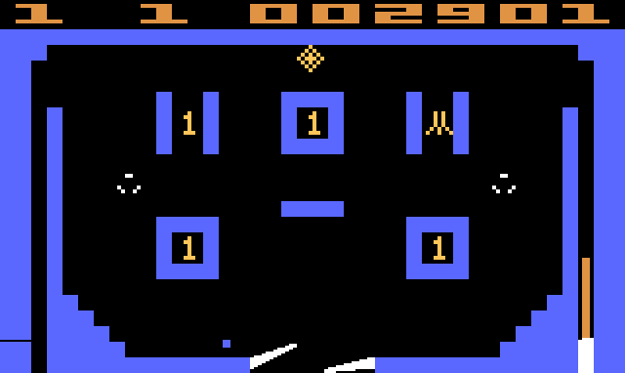
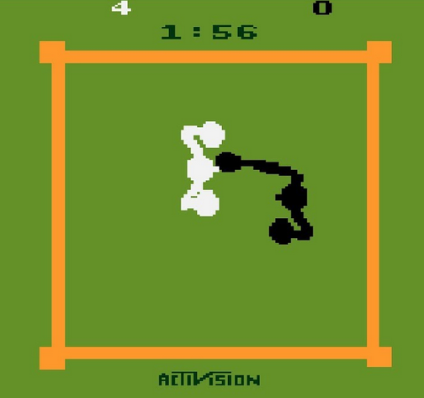
Professional human tester (100%-75%), random play (0%)
Blue bars is DQN
Gray bars is Linear learner
Notes:
http://files.davidqiu.com//research/nature14236.pdf

Slide 22
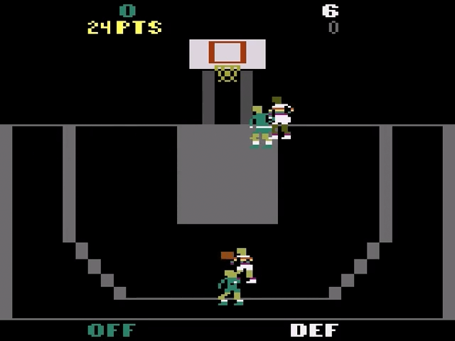
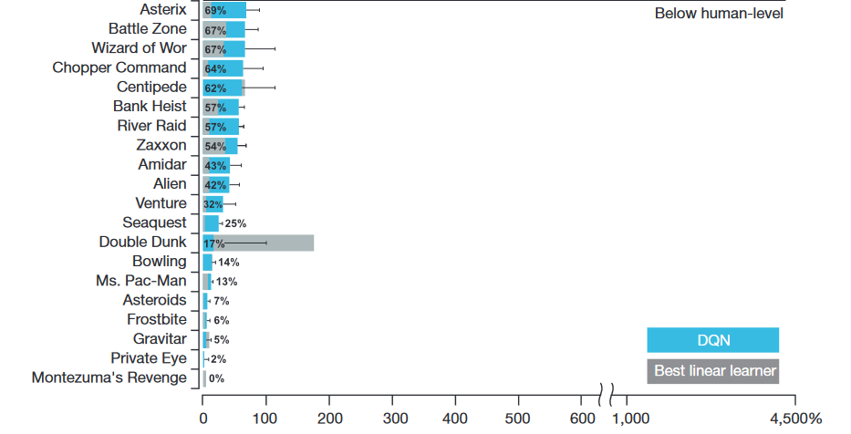
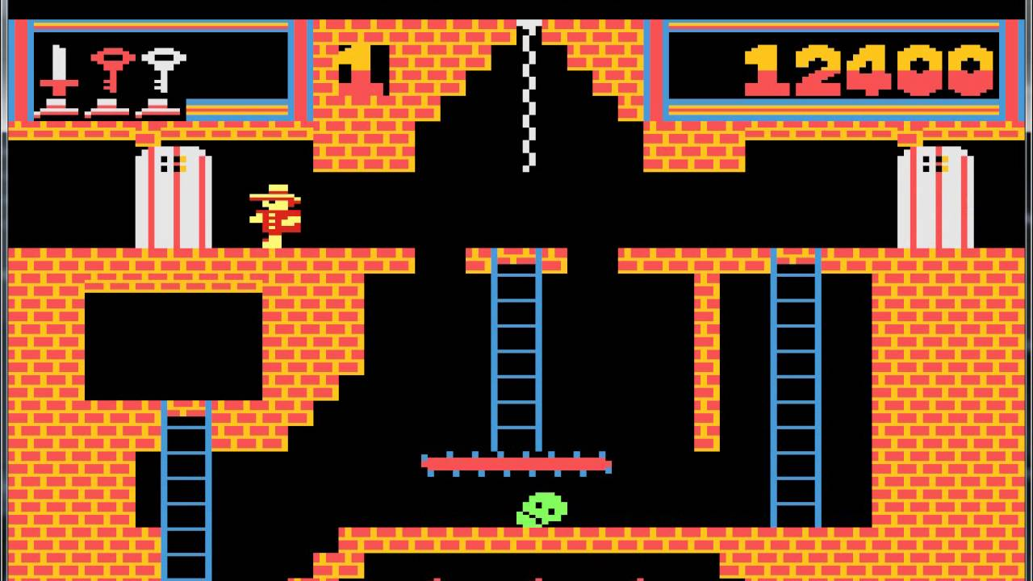
Professional human tester (100%-75%), random play (0%)
Notes:
http://files.davidqiu.com//research/nature14236.pdf
The images are Double Dunk and Montezuma’

Slide 23
Q-Learning limitations
The model can only handle a small discrete action space
No continuous action spaces (ex, steering wheel angle)
The model is not very complex
The model cannot learn policies that are stochastic and can change due to unseen probability distribution
It will always only try to maximize the reward, deterministically computing the Q function
The model is not very flexible
We can introduce policy gradient methods to address these limitations

Slide 24
Deep Reinforcement Learning Algorithms
There are 2 learning algorithms:
Value Learning (deep Q-learning)
Find $Q(s,a)$
$a=argmax_{a}Q(s,a)$
Policy Learning
Find $π(s)$
Sample $a\sim π(s)$
Now, we want to directly learn the policy function that returns the action for a given state
Notes:
We’ll start from Value Learning (Q-learning)

Slide 25
Policy Learning
Here we convert the Q-loss to the Policy Gradient
Deep Learning
State $s$
$Q\left(s, a_{1}\right)=30$
$Q\left(s, a_{2}\right)=0$
$Q\left(s, a_{3}\right)=7$
We compute the optimal policy $π(s)$:
$π\left(s\right)=argmax_{a}Q\left(s,a\right)=a_{1}$

Slide 26
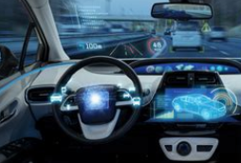
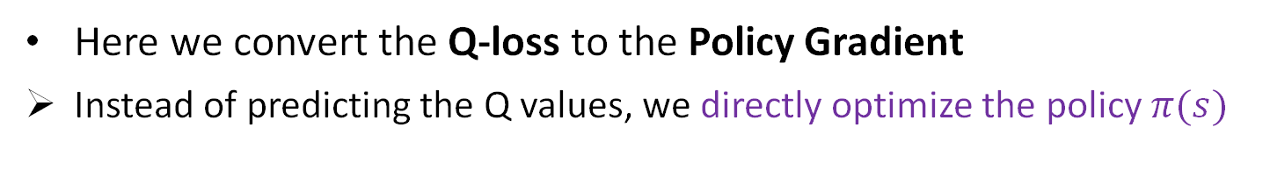
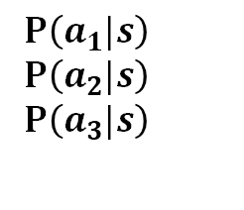
Policy Learning
Here we convert the Q-loss to the Policy Gradient
Instead of predicting the Q values, we directly optimize the policy $π(s)$
Deep Learning
State $s$
$P\left(a_{1}|s\right)$
$P\left(a_{2}|s\right)$
$P\left(a_{3}|s\right)$
The output is the probability that the action selected is the correct one (the one that gives the maximum reward)

Slide 27
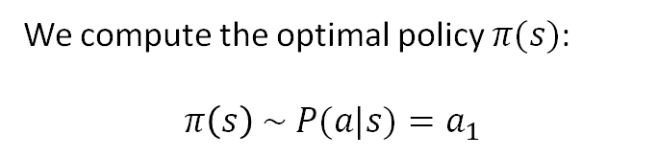
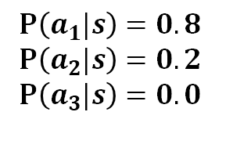
Policy Learning
Here we convert the Q-loss to the Policy Gradient
Instead of predicting the Q values, we directly optimize the policy $π(s)$
Deep Learning
State $s$
$P\left(a_{1}|s\right)=0.8$
$P\left(a_{2}|s\right)=0.2$
$P\left(a_{3}|s\right)=0.0$
We compute the optimal policy $π(s)$:
$π\left(s\right) \sim P(a|s)=a_{1}$
80% of the time
Notes:
There is 20% of probability to not move at all, and 0% to go left

Slide 28
Policy Learning
The policy network is predicting a probability distribution
The policy is defined by this probability distribution
We extract the action to take from this probability distribution

Slide 29
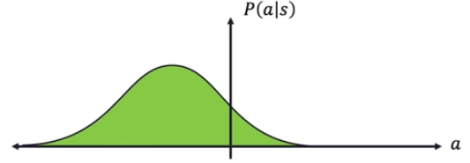
Policy Gradient vs Q-Learning
PG is more direct
We don’t learn first the Q-function, and then use it to optimize the policy, we just optimize the policy
PG can handle continuous action spaces
Not simply which direction, but also how fast in that direction
The choice comes from a probability distribution (ex, Gaussian)

Slide 30
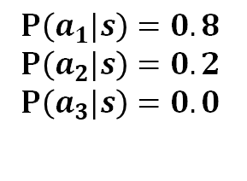
Policy Learning
Wait, but if we work in the continuous domain, there are infinite actions…
We need to change something
Deep Learning
State $s$
$P\left(a_{1}|s\right)=0.8$
$P\left(a_{2}|s\right)=0.2$
$P\left(a_{3}|s\right)=0.0$
This does not work in the continuous domain

Slide 31




Policy Learning
Wait, but if we work in the continuous domain, there are infinite actions…
We need to change something
We sample:
Deep Learning
Mean $μ=−1$
$$P\left(a | s\right)=N\left(μ | σ^{2}\right)$$
$$π\left(s\right)\sim P\left(a | s\right)$$
$$=−1.0 \left[m/s\right]$$
$=$ move left with that speed
State $s$
Variance $σ^{2}=0.5$
Only 2 outputs, but they describe the probability distribution over the entire continuous space
Notes:
Obviously, the probability distribution still sums to 1.0 (the integral of the gaussian)

Slide 32
Policy Learning
Wait, but if we work in the continuous domain, there are infinite actions…
We need to change something
We sample:
Deep Learning
Mean $μ=−1$
$$P\left(a | s\right)=N\left(μ | σ^{2}\right)$$
$$π\left(s\right)\sim P\left(a | s\right)$$
$$=−1.0 \left[m/s\right]$$
$=$ move left with that speed
State $s$
Variance $σ^{2}=0.5$
NOTE: the output does NOT need to be exactly -1.0 It could have been -0.8 or even +0.2
It is a probability distribution after all

Slide 33
Training Policy Gradient
We want to train an autonomous vehicle
Case study: Self-driving car
Agent: Vehicle
State: Camera, lidar, etc.
Action: Steering wheel angle
Reward: Distance traveled

Slide 34









Training Policy Gradient
We initialize the agent
We run a “non-trained” policy until it “crashes”
We record all the states, actions, and rewards
Decrease probability of actions that resulted in low reward
$(s_{3},a_{3},r_{3})$, $\left(s_{4},a_{4},r_{4}\right)$
Increase the probability of actions that results in high reward
$(s_{0},a_{0},r_{0})$, $\left(s_{1},a_{1},r_{1}\right),(s_{2},a_{2},r_{2})$
$$(s_{4},a_{4},r_{4})$$
$$(s_{1},a_{1},r_{1})$$
$$(s_{3},a_{3},r_{3})$$
$$(s_{2},a_{2},r_{2})$$
$$(s_{0},a_{0},r_{0})$$

Slide 35

Training Policy Gradient
We initialize the agent
We run a “non-trained” policy until it “crashes”
We record all the states, actions, and rewards
Decrease the probability of actions that resulted in low reward
$(s_{3},a_{3},r_{3})$, $\left(s_{4},a_{4},r_{4}\right)$
Increase the probability of actions that results in high reward
$(s_{0},a_{0},r_{0})$, $\left(s_{1},a_{1},r_{1}\right),(s_{2},a_{2},r_{2})$
$$(s_{4},a_{4},r_{4})$$
$$(s_{1},a_{1},r_{1})$$
$$(s_{3},a_{3},r_{3})$$
$$(s_{2},a_{2},r_{2})$$
$$(s_{0},a_{0},r_{0})$$

Slide 36
Training Policy Gradient
Note that the algorithm is not “smart”
It simply raises the probability of “good” events, and decreases the one of the “bad” events
In other words, it does not understand which actions are better than the others
$$(s_{4},a_{4},r_{4})$$
$$(s_{1},a_{1},r_{1})$$
$$(s_{3},a_{3},r_{3})$$
$$(s_{2},a_{2},r_{2})$$
$$(s_{0},a_{0},r_{0})$$

Slide 37




Training Policy Gradient
We repeat the process
We notice that now the car goes a little further before crashing…
$$(s_{4},a_{4},r_{4})$$
$$(s_{1},a_{1},r_{1})$$
$$(s_{3},a_{3},r_{3})$$
$$(s_{2},a_{2},r_{2})$$
$$(s_{0},a_{0},r_{0})$$

Slide 38

Training Policy Gradient
And again, and again
Until we are satisfied with the driving (no crashing!)
The car learned how not to crash without even knowing what the road lanes are
$$(s_{4},a_{4},r_{4})$$
$$(s_{1},a_{1},r_{1})$$
$$(s_{2},a_{2},r_{2})$$
$$(s_{0},a_{0},r_{0})$$
$$(s_{3},a_{3},r_{3})$$

Slide 39

Training Policy Gradient
We initialize the agent
We run a “non-trained” policy until it “crashes”
We record all the states, actions, and rewards
Decrease probability of actions that resulted in low reward
$(s_{3},a_{3},r_{3})$, $\left(s_{4},a_{4},r_{4}\right)$
Increase the probability of actions that results in high reward
$(s_{0},a_{0},r_{0})$, $\left(s_{1},a_{1},r_{1}\right),(s_{2},a_{2},r_{2})$
$$(s_{4},a_{4},r_{4})$$
$$(s_{1},a_{1},r_{1})$$
$$(s_{2},a_{2},r_{2})$$
$$(s_{0},a_{0},r_{0})$$
$$(s_{3},a_{3},r_{3})$$
But how to do these two things?

Slide 40


Training Policy Gradient
We define the Loss in this way:
$$−\log\left(P\left(a_{t} | s_{t}\right)\right)∗R_{t}$$
$P\left(a_{t} | s_{t}\right)$ is the probability of an action for a given state (log-likelihood of the action)
$R_{t}$ is the Reward
Ex, if $R_{t}$is high and the likelihood of $a_{t}$ given $s_{t}$is also high, the Loss will be great
This will make the action more likely

Slide 41

Training Policy Gradient
We define the Loss in this way:
$$−\log\left(P\left(a_{t} | s_{t}\right)\right)∗R_{t}$$
Gradient Descent update rule:
$$W_{t+1}=W_{t}−∇Loss$$
$$W_{t+1}=W_{t}+∇\log\left(P\left(a_{t} | s_{t}\right)\right)∗R_{t}$$
This is the Policy Gradient
Notes:
The name comes from that

Slide 42


Reinforcement Learning in Real Life
Game of Go

Slide 43
Reinforcement Learning in Real Life
2016 AlphaGo defeats the human champion Lee Sedol (1-4).
This is how it works:
Deep learning model created observing human professionals playing
This is Supervised learning
Self play to enhance the game quality (superhuman performance)
This is Reinforcement learning
A separate Deep learning model was trained on understanding how good the state of the board is
A Monte Carlo tree search is used to search the best move

Slide 44

Reinforcement Learning in Real Life
2018 AlphaZero defeats Stockfish in Chess
Purely Reinforcement learning
There was no pre-training on human data
AlphaZero defeats AlphaGo in the Game of Go

Slide 45

AlphaZero
Stockfish 8
Notes:
https://chess24.com/en/watch/live-tournaments/alphazero-vs-stockfish/3/1/5

Slide 46

AlphaZero
They noticed that, when AlphaZero has an advantage, it starts to simply consolidate its position
Stockfish 8

Slide 47

AlphaZero
Stockfish is VERY good at defending.
Moving the pawn in H4 is brilliant.
This blocks the black knight …
…but AlphaZero moves it anyway sacrificing it
Stockfish 8

Slide 48

AlphaZero
Winning position for AlphaZero
AlphaZero idea is to move the rook to the H file
But StockFish is really a great defender and finds the defence…
Stockfish 8

Slide 49

AlphaZero
Winning position for AlphaZero
AlphaZero idea is to move the rook to the H file
But StockFish is really a great defender and finds the defence…
Stockfish 8

Slide 50

AlphaZero
AlphaZero decides to not defende the queen
In here, white captures the queen, loses its queen, but gain the black knight
End of the story for Black…
Stockfish 8

Slide 51
AlphaZero
But AlphaZero finds an amazing move
Stockfish 8

Slide 52

AlphaZero
After few captures, Black situation seems quite bad
Stockfish 8

Slide 53

AlphaZero
After few captures, Black situation seems quite bad
But AlphaZero keeps exchanging pieces without giving up…
Stockfish 8

Slide 54

AlphaZero
Last move of the match
White gives up
Stockfish 8

Slide 55

Reinforcement Learning in Real Life
AlphaStar
MaNa
AlphaStar is a Deepmind’s bot by Google
MaNa is the best player in the TeamLiquid team

Slide 56


Slide 57
Why did MaNa lose?
MaNa trained on StarCraft II since he was 5
MaNa referenced at the bot as “he”
“His” moves where totally human-like
Our brain tries to minimize the noise by filtering out things which it perceives to be irrelevant
MaNa’s brain was automatically skipping information
AlphaStar did not

Slide 58
However…
“This bot is high GM for sure[…] AlphaStar was killing him from the beginning but then MaNa found a huge weakness. The bot didn't know how to deal with warp prism harass. Bought MaNa a ton of time when all the bot needed to do was build a phoenix to kill the prism.
Let's go humanity!” - u/Reckie
Other issues:
AlphaStar had ~1000 APM (Actions Per Minute)
It was able to “see” the full map at once
Its microeconomy was “too good”

Slide 59
However…
Taking care of this issues… AlphaStar lost against MaNa
In 2018, the world champion was Serral. AlphaStar did not compete against him.
Other issues:
AlphaStar had ~1000 APM
It was able to “see” the full map at once
Its microeconomy was “too good”

Slide 60
Resources
Paper: StarCraft II: A New Challenge for Reinforcement Learning
https://arxiv.org/pdf/1708.04782.pdf
Blizzard’s API to train ML algorithms (agents)
It provides full external control of StarCraft II
The offered dataset contains millions of human games
https://github.com/Blizzard/s2client-proto
DeepMind tool to learn StarCraft II (open source)
https://github.com/deepmind/pysc2
Google Colab code
https://colab.research.google.com/drive/1AzCKV98UaQQz2aJIeGWlExcxBrpgKsIV

Slide 61
StarCraft II Learning Environment
SC2LE is a reinforcement learning environment based on the game StarCraft II by Blizzard.
Challenges:
It is a multi-agent problem with multiple players interacting
There is imperfect information due to a partially observed map
It has a large action space involving the selection and control of hundreds of units
It has a large state space that must be observed solely from raw input feature planes
It has delayed credit assignment requiring long-term strategies over thousands of steps

